Slide 1
How to work with audiences

Slide 2
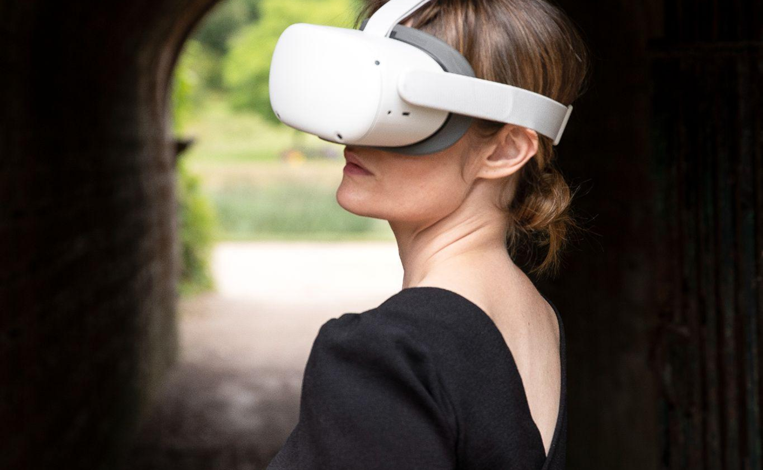

dr Kerryn wise
Interdisciplinary artist & researcher working across dance, performance, and immersive technologies
Notes:
•Making work for over 25 years at the intersections of art and technology
•Co-lead of Displace Studio, a Mixed Reality Performance Studio with Ben Neal.
•As a practitioner audiences have always been at the heart of my practice, whether that is considering and mapping the audience journey through a piece of work or gathering feedback to better understand how my work is meeting audiences. I consider audiences very early in my process, considering who I want to reach and why and how I can make that happen. I map the whole audience journey: practically – where do I want them to look, to stand, to move, as well as how I want them to feel at different points.
•My research as a fellow on IA, aims to understand how the use of new technologies impacts artistic approaches and audience experience of arts and cultural content. This session aims to introduce some tips about audience studies but also get some feedback on what would be useful to you and future artists on the programme.
•My research as an artist has focused on developing new practices with dance and new technologies specifically VR, mixed-reality and volumetric capture. In developing these works, involved audiences through user/play testing at various stages of development, and towards the end of a project often in a more public sharing.
•I would survey audiences to gather feedback on a range of topics including demographics, prior experience, content/themes of the work, user experience and marketing materials.
•This all helps to inform me about who my audiences are, how the work is meeting audiences, whether my themes and ideas are communicating, any technical issues, as well as how my marketing materials are working. On my recent work Replica, the marketing image was not communicating well with audiences, so we are have developed our main image and logo for the work to better fit the peice and the audiences we want to attract.

Slide 3
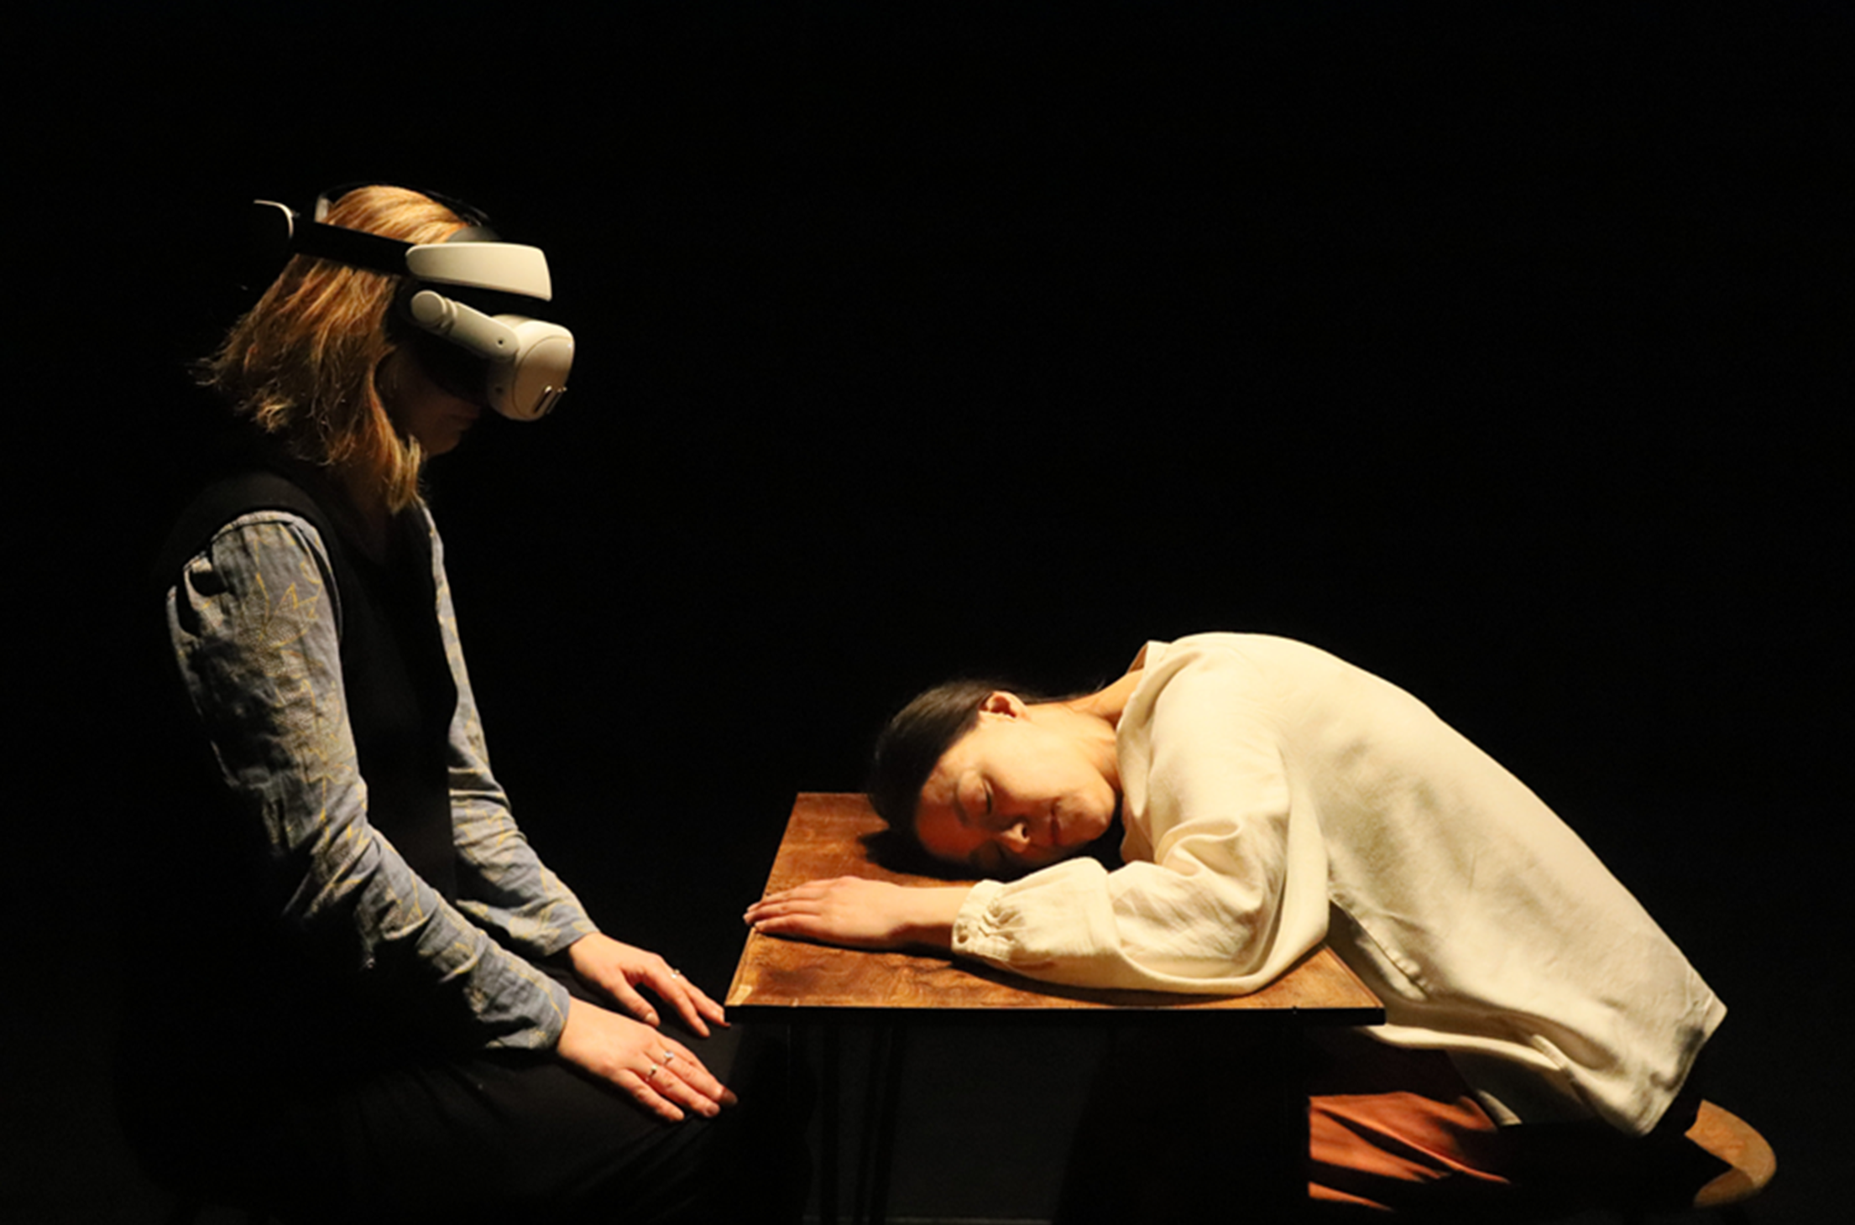
Why are audiences important?
To your practice?
To your process?
To your final experience/
prototype?
Notes:
Focus today is on prompts to start to support you to think about your audiences.
Does it matter to you if your work meets an audience or not? Explore projects may not meet an audience.
How could sharing the work with audiences help you to understand the artistic impact and intention of your work?
How could sharing the work with audiences help you to develop the user-experience, accessibility and impact of your work?
Is you content autobiographical / sensitive – make sure you consider safeguarding for yourself and any audiences you survey.

Slide 4
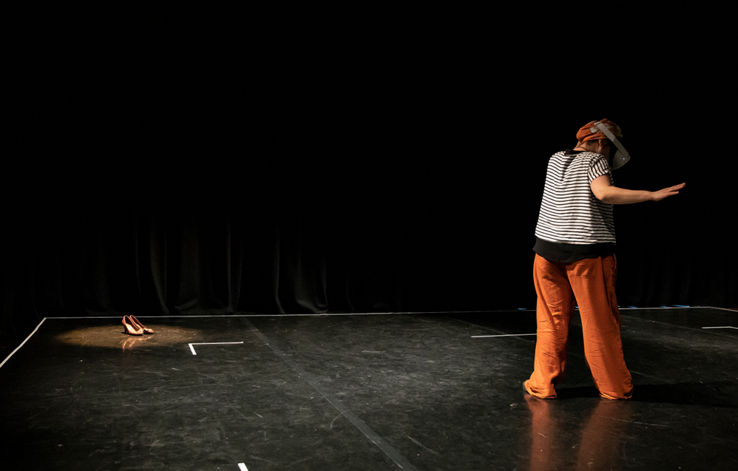
Some questions to start
Do you have an existing audience for your practice?
Do you have a (different) target audience in mind for your specific project?
If yes, how will you reach them?
At what point do you start to consider your audience?
Notes:
How will you help your existing audience translate to you new work? Easiest audience as they already support your work…
Making an audience engagement plan can be useful if you are trying to reach new and different audiences. Find partners/networks you can tap into.
Considering your audience early in a project can be useful as often user-testing can/should be an integral part of your process. Getting feedback from audiences during a project’s development can take time so its good to build this in from the start.

Slide 5
What do you want to know?
Demographics: useful to understand who you are and aren’t reaching. Often needed for funders
Overall User-Experience: prior experience, on-boarding/offboarding, flow and transitions, levels of immersion, technical glitches or unclear prompts, accessibility
Artistic Features: sound design, movement, imagery, text etc.
Artistic Interpretation: narrative, themes, How did it make them feel? What were they drawn to? How would they describe it to others?
Marketing and Ticketing: Did your marketing materials communicate the work? What about info about ticket prices and the best places audiences may want to experience your work?
Notes:
So, now that you have an audience in mind…
Demographics: Age, gender, race, geography, income,
On-boarding/off-boarding define
Marketing: Immersive experiences can be new to many public – consider the language used and imagery in any marketing materials…
Beauty Book Creative Evaluation Example

Slide 6
How are you going to survey your audience?
questionnaires (open/closed), focus groups, observation, freeform drawing/post-it notes
newer ways that capitalise on the immersive technologies you may be exploring, such as VR casting and biometrics
Beauty Book Example
Immersive Arts Audience Resource bank
Notes:
This will very likely be impacted by how much time/resource you have!
Talk through each one:
Questionnaires – Microsoft forms = very simple and gives you basic analysis and some useful charts and visuals.
Focus groups – more conversational and allows discussion between audiences
Observation (great if you have time and can take detailed notes. Where are your audiences looking/moving? What holds their focus?
Simple, quick post-it note feedback, comment book.
Facades we did VR casting, noting where the audience members were looking, to be able to make comparisons and note reoccurring issues. Looking wrong way, we added a small mark on the floor which helped them to face the correct way.
My technological examples were very fruitful but also time consuming but might be very useful for early stage, small audience sample testing.

Slide 7

What resources do you need?
Someone to support you with drafting questions to ask?
Someone to gather the audience feedback on your behalf at events?
A quiet space to collect feedback?
Example questionnaires? Example feedback consent forms?
Access to recording devices?
Existing audience feedback models to use?
Support with transcribing and understanding the feedback?
Support with translating the feedback into graphics/audience quotes to use?
Anything else?
Notes:
Break Out Room: Barriers to evaluating audiences?
How can we help? Please add to the chat any things that you think would be useful.

Slide 8
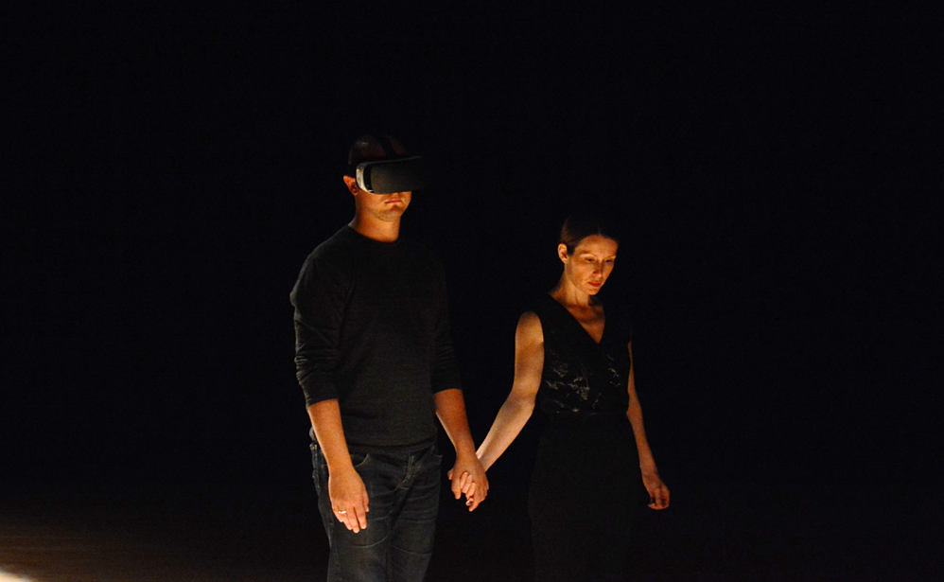
Signposting
Audience Resource Bank - Immersive Arts
NB* These are optional and there is no requirement to use these resources!
Email me: kerryn.wise@uwe.ac.uk

Slide 9
Thank you.
Diolch.
www.immersivearts.uk
Facebook
Immersive Arts UK
Instagram
@immersivearts_uk
BlueSky
@ImmersiveArtsUK
LinkedIn
Immersive Arts UK

